Slide 1











Hack4soc 2.0
RV College of Engineering
POWERED BY

Slide 2


Team Name : Pinnacle Performers Theme : " Seamless workflows with smart document handling: AI document management with smart FINTECH integration "
TEAM MEMBERS
Mohammad Ali Al-sakkaf
Vishal Prajwal M
Sumukha G Kambaloor
Ganeshdarshan Bhat

Slide 3

PRoBLEM sTATEMENT
" Seamless workflows with smart document handling:
AI document management with smart FINTECH integration "
Simplified and Refined:
In today's business world, dealing with a ton of documents can be a real headache. Imagine having to sign or edit them online – it's not always as smooth as we'd like.
We want to make this process simpler and time efficient. Think about creating a document – making it look good,easily editable getting the right people to sign it, and working on it together with your team and organisation.
The tools out there are missing some smart features that could speed things up, like just entering the subject using AI to generate the text according to the hierarchy provided stored as a pdf document and automatically suggesting the best person to sign.
Professional Touch:
In the fast-paced landscape of modern business operations, efficiently handling a large number of PDF documents poses a formidable challenge along with the obvious time constraint. Integrating seamless e-signature capabilities becomes intricate, involving complexities such as dynamic document layouts, hierarchical signatory identification, and fostering collaborative editing processes.
The absence of sophisticated AI functionalities in existing systems exacerbates delays, hindering automated document creation and intelligent signature recommendations

Slide 4
SoLuTioN
AI Document Management System Overview
Key Features:
AI-Driven PDF Creation: Utilizes OCR and generative AI for automated
document building and preparation for signatures.
E-Sign Capabilities: Allows sending documents for signatures within and outside the organization, supporting various signing methods.
AI Signature Recommendations: Predicts the suitable signatory
for documents based on organizational hierarchy and document context.
Intuitive UI for PDF Design: Drag-and-drop interface for customizing
PDFs, with complete control over document components.
Prompt-to-PDF Generation: Converts user-written prompts into tailored PDF documents, editable on the platform.
Collaborative Environment: Supports multiple users for document
sharing, editing, and review within an organization.
Comprehensive Document Management: Offers storage, tagging, and searching functionalities for efficient document handling.
Purpose: Streamlines managing and signing PDF documents for businesses, using advanced AI technologies.
This system significantly enhances efficiency in document processing and management, particularly beneficial for large organizations with complex signing requirements.

Slide 5
DATA FLoW DIAGRAM (DFD) pinnacle performers pinnacle docs:

Slide 6


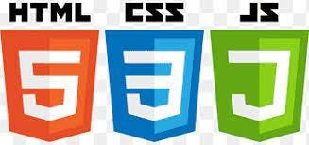

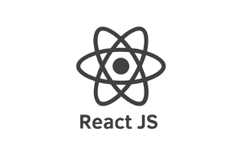




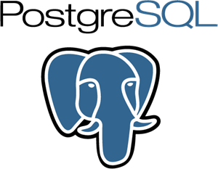



Technology Stack
Show-Stopper
Frontend: HTML,CSS,JavaScript
Backend: Django / Flask
Database: PostgreSQL , MongoDB
Cloud Platforms: Google Firebase
Version Control: Git
Development tools: IDE (VSCode, PyCharm)
Communication: RESTful API, OPEN API
Libraries: reportlab, PyMuPDF, Pytesseract
gemini
1. Technical Complexity and AI Accuracy: Developing a system that seamlessly integrates OCR, generative AI, and predictive algorithms for signature recommendations involves high technical complexity. Ensuring the accuracy and reliability of these AI features, especially in diverse and unpredictable real-world scenarios, can be challenging.
2. Data Security and Privacy Concerns: Handling sensitive documents and personal signatures raises significant data security and privacy concerns. The system must comply with stringent data protection regulations like GDPR, and any breach or vulnerability could be a major setback.
3. Scalability and Performance Issues: Ensuring the system can scale effectively to handle large volumes of documents without performance degradation is crucial. Any lag or inefficiency in processing could deter potential users.

Slide 7
Generative ai for efficient document handling
Objective:
To help the NGOs and mankind
NGO software server and sign in portal and portal request
Other applications help financial institutes and health related sectors to get signature for insurance and technology industry
Within and outside the organisation
Traditional methods
OCR (optical character recognition)
Tideous Time consuming and inefficient
Problem statement write subject using chat gpt
Convert to pdf
Edit it
Save it
Share it
Take printout
Get it signed physically

Slide 8
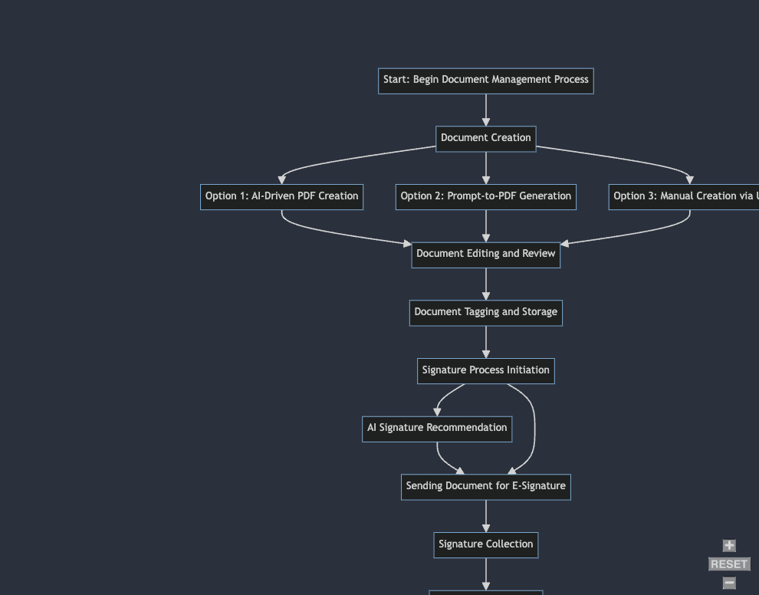
Flow chart Solution efficient method of document handling

Slide 9
Workflow
Step 1:Generate a promt and enter the Subject
Step 2:Click on summarize and the Content gets automatically generated
Step 3:Edit if required
Step 4:If not click on Pdf download
Step 5:Smart sign recommendation system based on Auto assigned for appropriate person according to hierarchy flowchart
Smart document recommendation system using vector database
Step 6:Author sends file as a email request for client to sign through e sign
3 options for client
1 reject. (notifies the author).
2 redirect (notifies the author (author has the right to go either up or down the priority and the client cant redirect it))
3 accepts it and signs it
If he doesn’t do anything after some time it will again notify him.

Slide 10
Features we couldn’t add
1.Image comparison through ratios of x and y axis using coordinates and threshold setting greater than or equal to 0.8 means accurate 1 means perfect less then 0.8 to 0.4 is reverification and less than 0.4 is reject.
2.Ml model dataset
3.End to end encryption

Slide 11
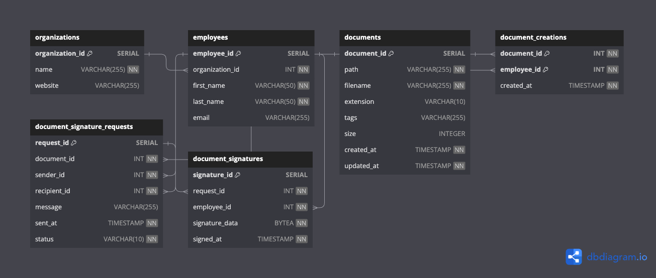
Features we couldn’t add database integration

Slide 12
1.Document storage/management 2.person to get registered on software 3.sign(user authentication using firebase) stored in firebase cloud.

Slide 13
Value addition and cost effective solution
Saves time.
Saves effort
User friendly
Streamlined document adding
https://devpost.com/softwarehttps://devpost.com/software

Slide 14
BUsINEss scoPE
Market Demand:
With the growing digitization of businesses and the increasing need for remote operations, there's a high demand for efficient document management systems. The AI Document Management System addresses this need, providing a solution that streamlines document handling, creation, and signing processes.
Target Market:
The primary market includes large corporations and organizations with complex hierarchical structures and a high volume of documentation needs. It also targets small and medium-sized enterprises (SMEs) looking for cost- effective, efficient document management solutions.
Revenue Streams:
Subscription-Based Model: Charging businesses for monthly or annual subscriptions to the platform.
Pay-Per-Use Features: Offering certain advanced features like AI signature recommendations on a pay-per-use basis.
Enterprise Solutions: Customized packages for large enterprises, providing tailored features and integrations.
Competitive Advantage:
The integration of AI for signature recommendations and OCR for document digitization sets this system apart from traditional document management systems, offering higher efficiency and automation.
Expansion and Scalability:
The system has potential for scaling up to include more advanced AI features and adapt to various industry needs, such as legal, medical, or educational sectors.

Slide 15

socIETAL RELEVANcE
Environmental Impact: Environmental Impact: By promoting paperless operations, the system contributes to environmental sustainability. by reducing the need for physical document storage (wooden storage equipments like rack and almirah in which paper documents are stored) and hence reduces deforestation, saves printing ink, and paper usage which has a positive impact towards the environment. Ink dye production can be harmful due to the presence of hazardous substances in the raw materials used.
Accessibility and Inclusivity: The system can be designed to be accessible, aiding individuals with disabilities in document handling and signing processes. This promotes inclusivity in the workplace.
Efficiency in Public and Non-Profit Sectors: Implementation in public sector and non-profit organizations can streamline their document management, leading to more efficient public services and resource allocation.
Data Security and Privacy: With increasing concerns about data privacy, this system can offer secure document handling and signing processes, ensuring compliance with data protection regulations.
Educational Use: The system could be adapted for educational purposes, aiding in the management of academic documents and facilitating remote learning and administration.

Slide 16
socIETAL RELEVANcE
Financial impact: by promoting online operations it'll save a lot of time and money. for example: earlier people had be physically paying electricity and water bills in an office standing for hours together and paying money for transportation from their home to office but after the arrival of online bill payment system people need not wait hence save time and save transport cost. also usage of AI reduces dependency on manpower and does things in less time and more efficiently and accurately with less maintenance cost and its an OTI (one time investment) and more cost efficient than manpower and more accurate and reliable.
Data Safety : suppose if the data is stored in racks or in any other physical means there are chances of water leakage that destroys the files or it maybe stolen too. there are some more additional risks like catching of fire and termite infestation (termites eat the paper) and some times even rats and rodents eat them. one more problem is that if the files are kept unadministered for a long time the ink starts smudging and fading away

